Slide 1
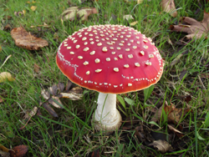
Mushroom classification
Edible or poisonous

Slide 2
INTRO
Subject matter
Mushrooms have been eaten by humans for thousands of years.
All mushrooms contain protein, fiber, and the powerful antioxidant selenium.
For these reasons and more, mushrooms are a very common food today.
As is well known, some mushrooms contain toxic substances, which in some cases can cause death.
The classification of edible or poisonous mushrooms is of great significance for the simple reason that mushrooms are such a common food that grow in most countries, which can entice many people, especially kids, who do not understand the field to eat them.
Thus, developing software that effectively identifies the differences can save lives.

Slide 3
INTRO
Dataset
The given data contained 8,124 rows and 13 attributes, numerical and categorial.
Each row represented a mushroom, and it was labeled as edible or poisonous.
The dataset is balance with 4208 edible and 3916 poisonous samples.
Contain 848 samples with missing values.

Slide 4
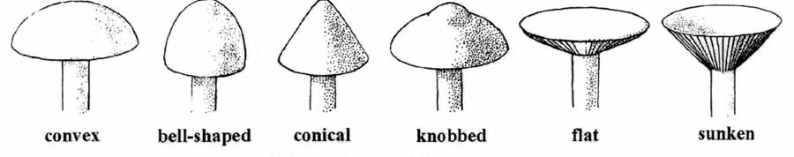
INTRO
Attributes
classes: Target attribute. Edible or Poisonous. cap-shape: Categorial, bell,conical,convex,flat,knobbed,sunken cap-surface: Categorial, fibrous,grooves,scaly,smooth cap-color: Categorial, brown,buff,cinnamon,gray,green, pink,purple,red,white,yellow odor: Numeric, continuous - measured odor level, units undefined gill-attachment: Categorial, attached,descending,free,notched gill-spacing: Categorial, close,crowded,distant stalk-shape: Categorial, enlarging,tapering veil-type: Categorial, partial,universal veil-color: Categorial, brown,orange,white,yellow ring-number: Categorial, none,one,two population: Numeric, continuous - measure of density of mushroom clusters latitude: Numeric, continuous - latitude of sample longitude: Numeric, continuous - longitude of sample

Slide 5
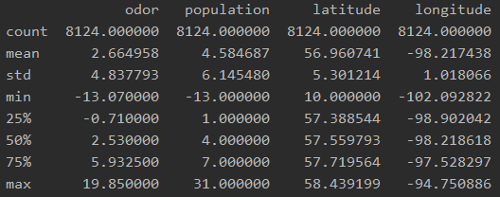
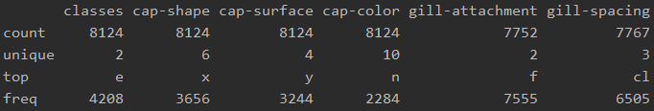
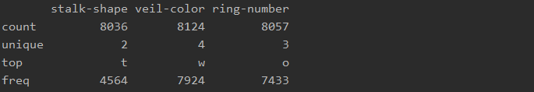
INITIAL DATA ANALYSIS
Feature statistical analysis
Numerical features: Categorical features:
Notes:
The requested cleaned csv file is under the folder data

Slide 6
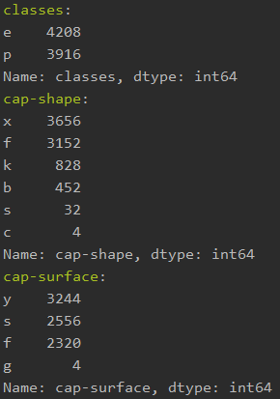
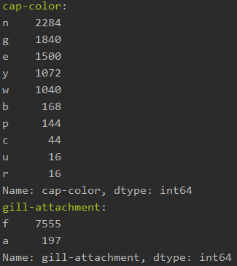
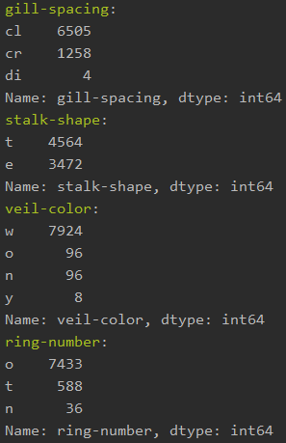
INITIAL DATA ANALYSIS
Feature statistical analysis
Categorial features – Number of occurrences for each value:
Notes:
The requested cleaned csv file is under the folder data

Slide 7
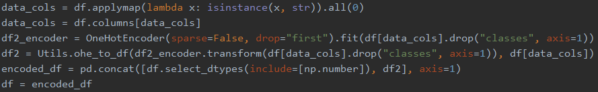
INITIAL DATA ANALYSIS
Feature statistical analysis
Formatting errors:
The given columns in the dataset are numerical. I will change the columns to the names given in mushrooms.txt file, to better understand the data.
For “gill-spacing“, I make it categorical as all the rest, by changing the values from -1,0,1 to c, r, d.
To handle categorical data, I was able to generate a table filled with entirely binary data, where 1 is present if a feature of a given column was present, and 0 otherwise.
Notes:
The requested cleaned csv file is under the folder data

Slide 8
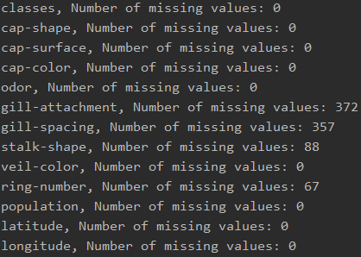
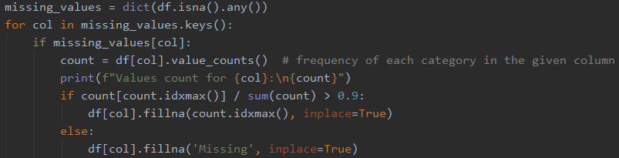
INITIAL DATA ANALYSIS
Feature statistical analysis
Number of missing values for each feature:
We can see that only categorical features have missing values.
To handle missing values, I will use 2 different methods:
If 1 category is above 90% from all the values in the current feature, I will assign missing values to this category.
Else, create new category "MISSING "and put assign the missing values as the new category.
Most of the missing values will be Missing, as most of the categorical features are balanced.

Slide 9
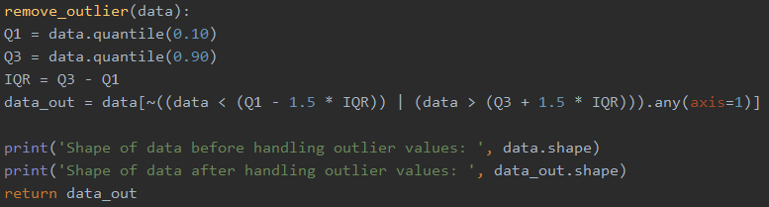
INITIAL DATA ANALYSIS
Feature statistical analysis
Handle outliers:
To identify and remove outliers, I will use the 1.5xIQR rule.
I decided to use this method because it can handle categorical data.

Slide 10
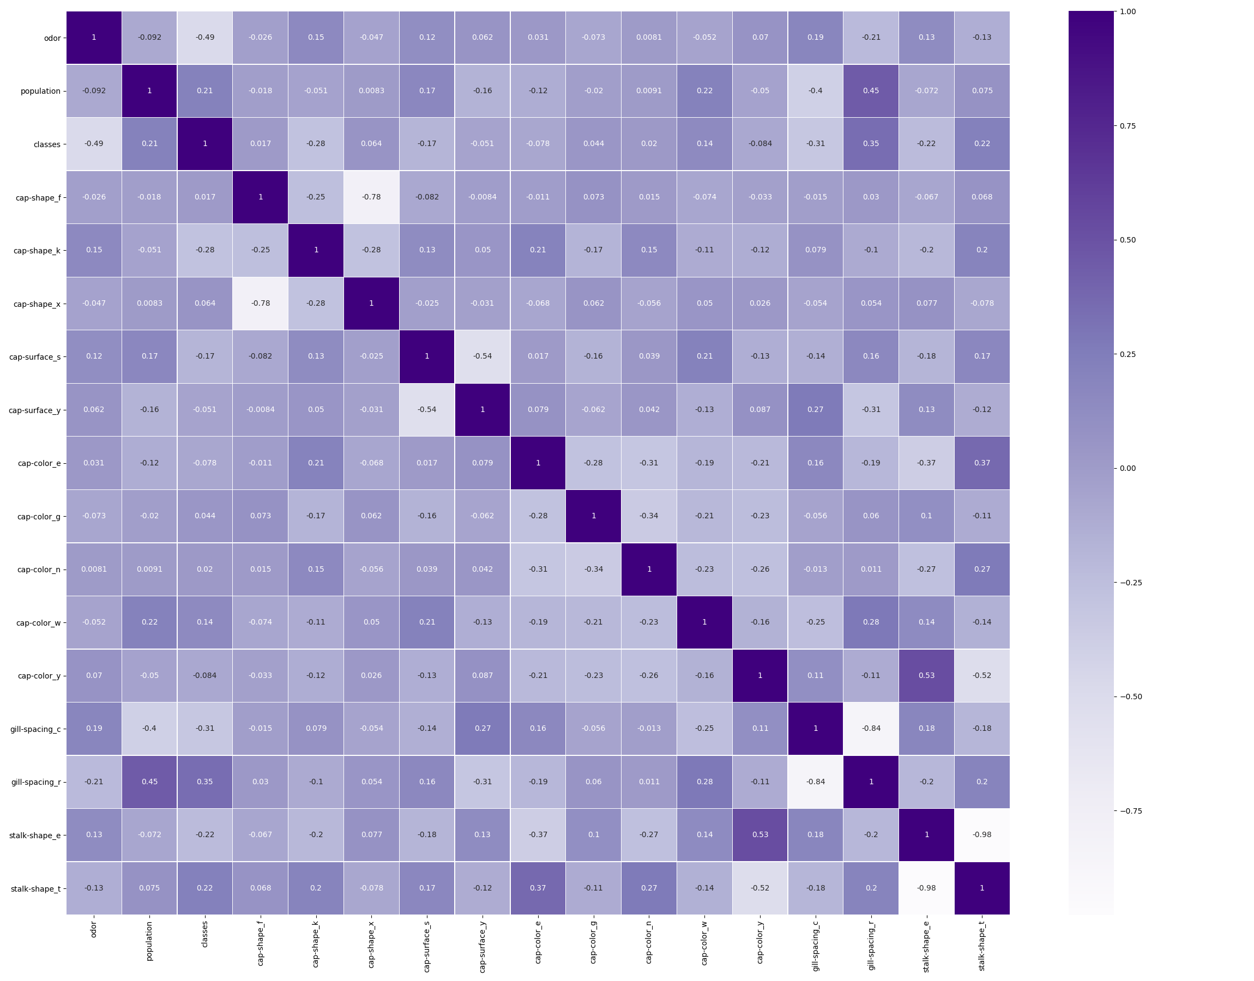
Exploratory Data Analysis
Feature correlation:
After computing the correlation matrix,
We can notice that the correlation between
Some features and the target attribute is very low,
So, we will delete features with correlation of less then
0.015 with the target from the dataset.
We can also see that “odor” is the most correlated
feature to the target attribute.

Slide 11
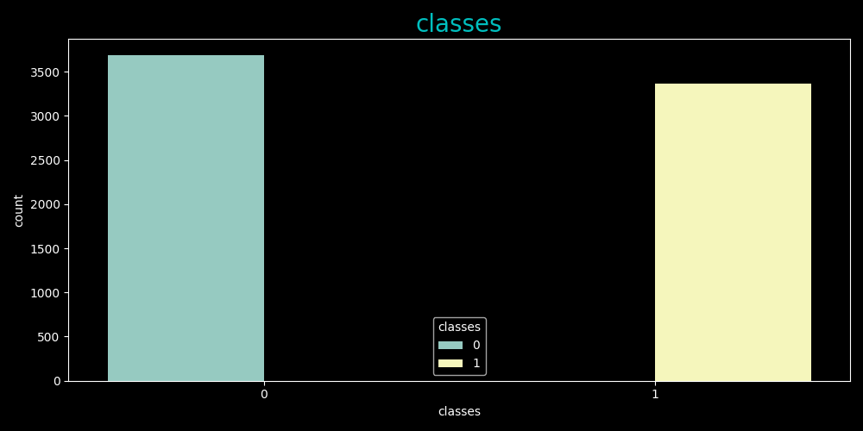
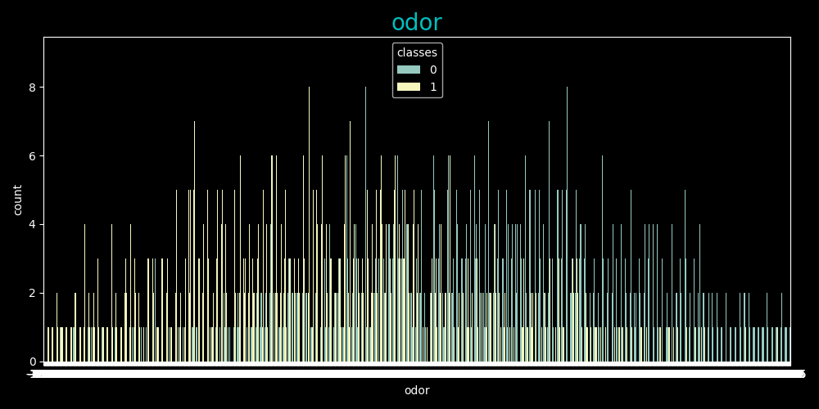
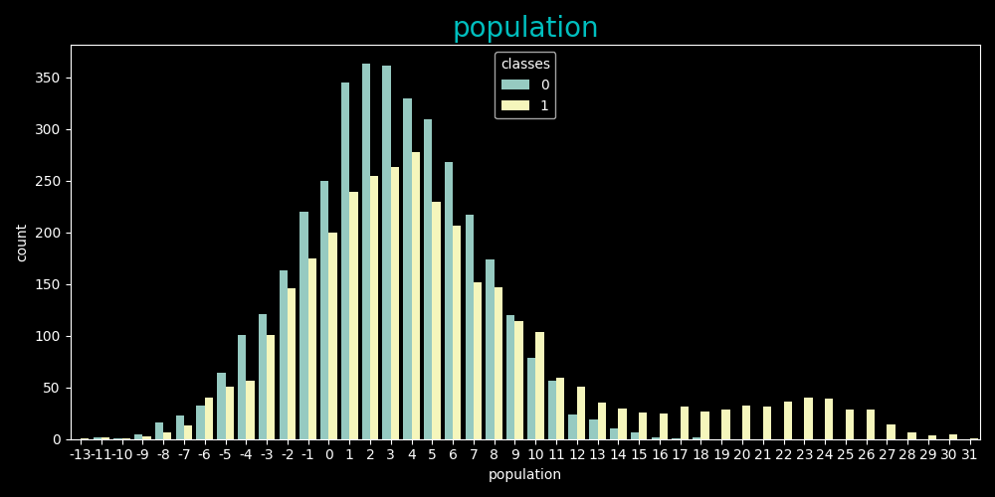
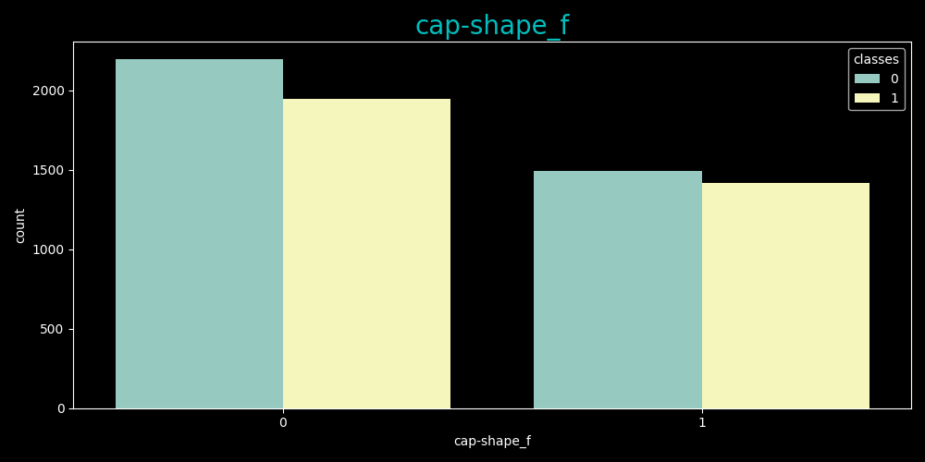
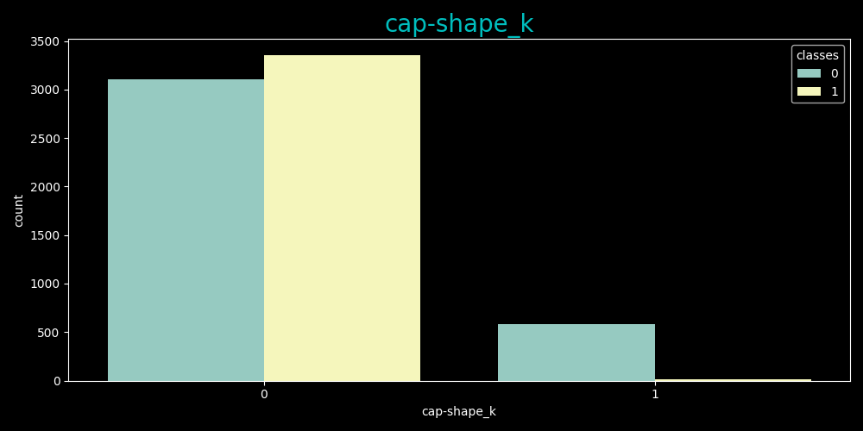
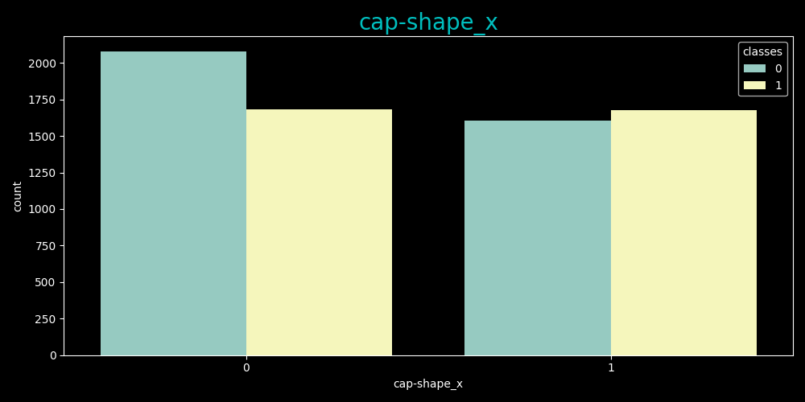
Exploratory Data Analysis
Analysis of each feature
Classes are balanced.
Odor is the most correlated feature to “classes”
odor and population distributed normally.
Cap shape is balanced when = “f” or “x”, but, when the cap shape is “k”, in almost all cases the class will be 0.

Slide 12
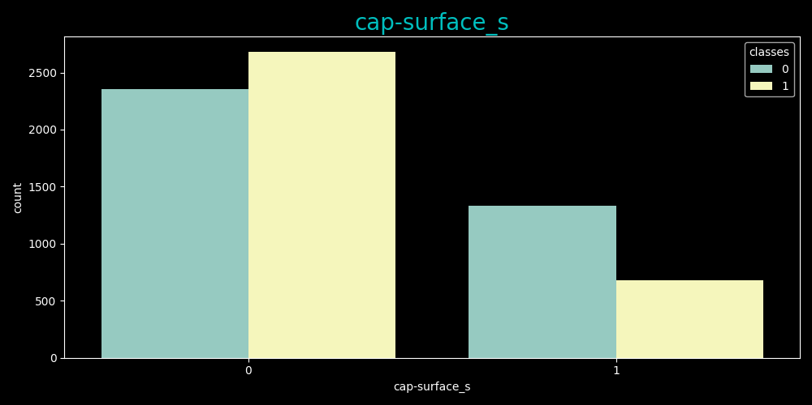
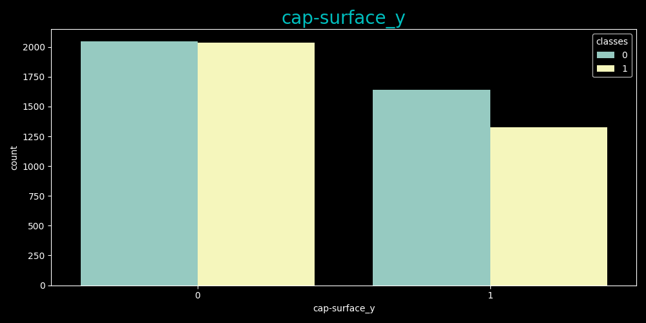
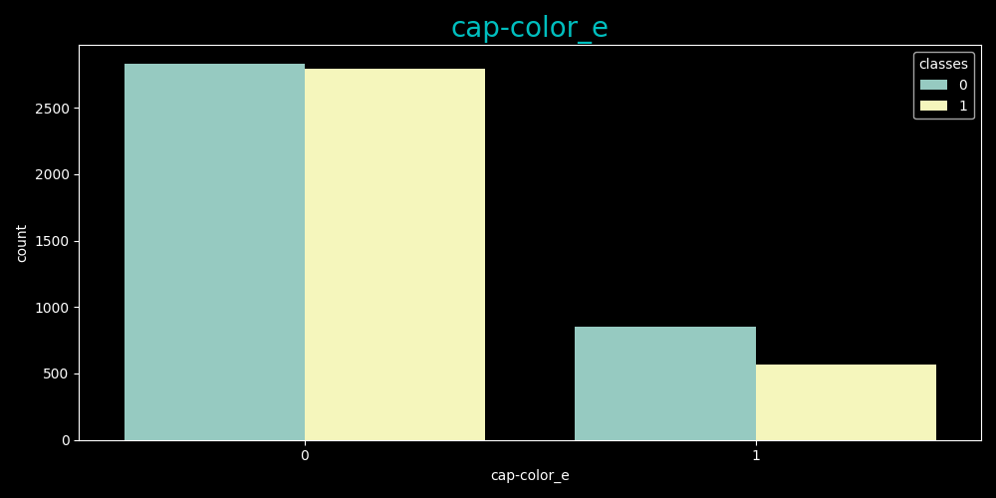
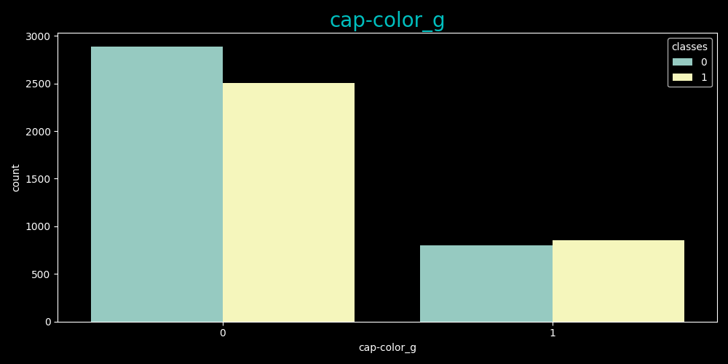
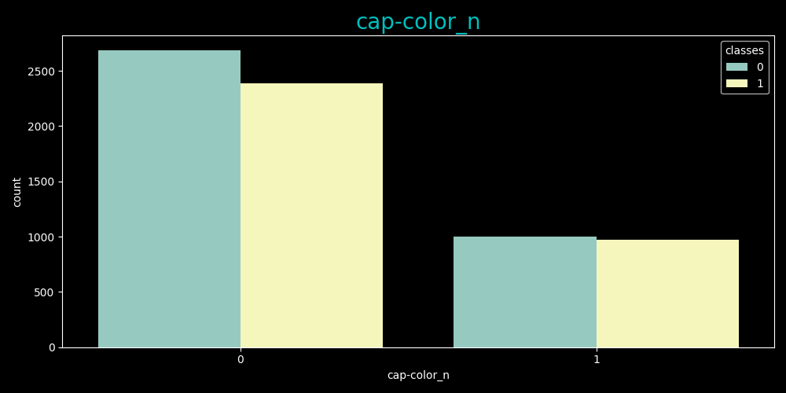
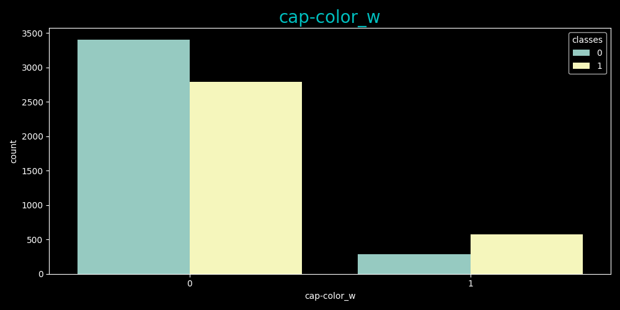
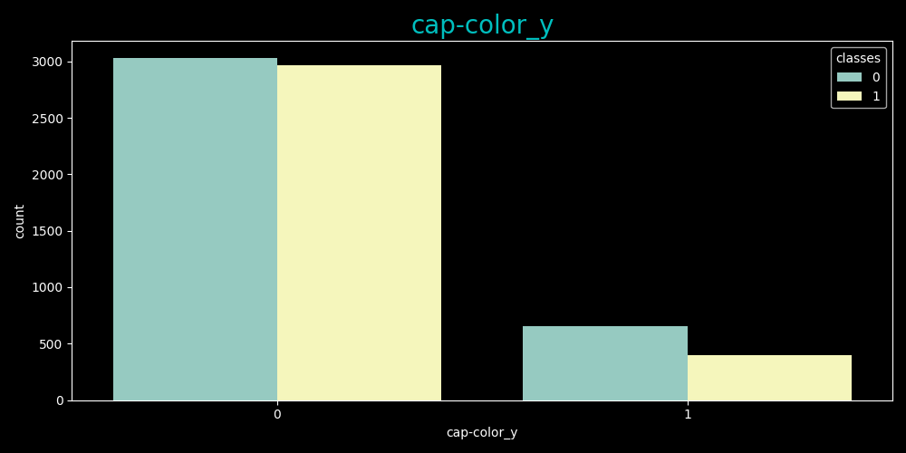
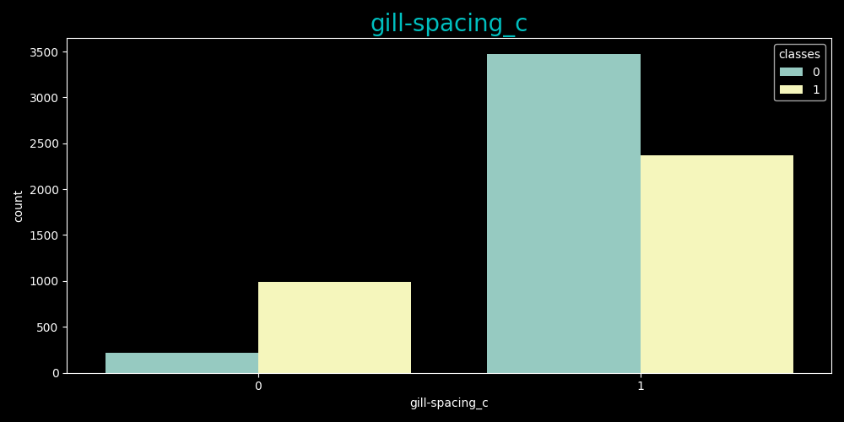
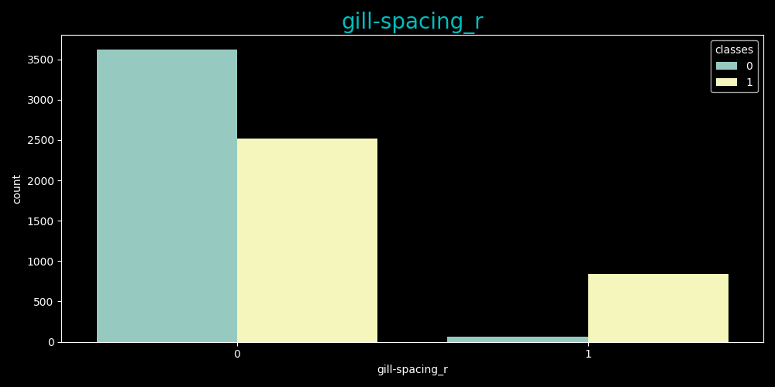
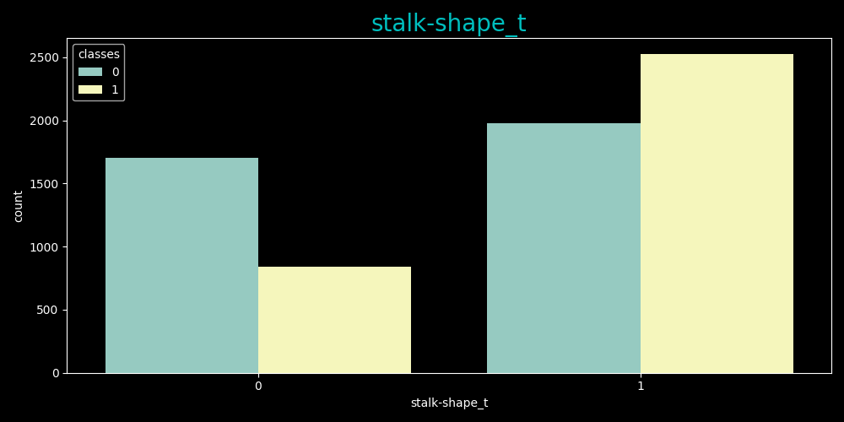
Exploratory Data Analysis
Analysis of each feature
Cap surface is balanced.
Gill spacing is balanced, but when = “r” in almost all cases the class will be 0.
Stalk shape is balanced.
Latitude and longitude correlation with “classes” is below the threshold, Thus, they will be removed.

Slide 13
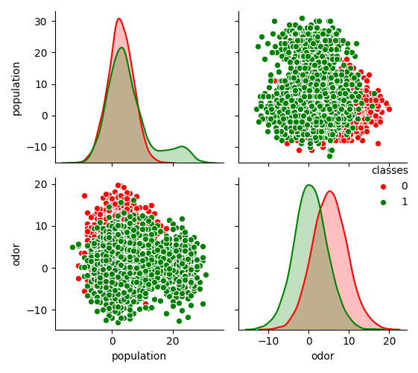
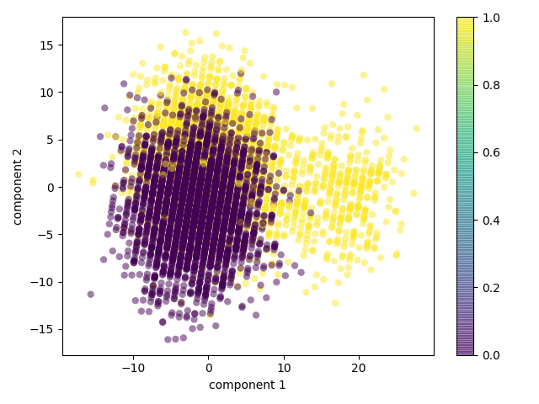
Exploratory Data Analysis
Interesting features
odor and population:
Continues attributes with the most influence on the data.
We can observe from this plot that both are normally distributed,
even when looking at the distribution for each class alone (0 or 1).
Another observation is that they can be separated by circle decision boundary.
PCA Plot:
Using PCA we can get better understanding of the data,
by visualizing the first and second component.
In this plot we can see that the data can be separated by those
components using Gaussian Naïve bayes or svm with kernel.
More than that, it means that with more features, the data will be
Even more separable.

Slide 14
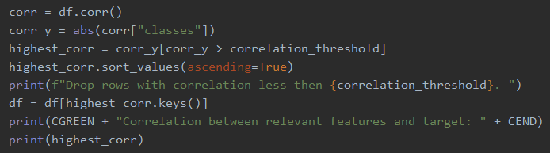



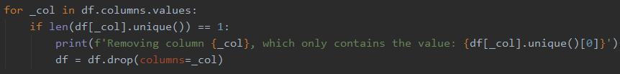
Exploratory Data Analysis
Additional data cleansing
Delete features that have low correlation with “classes”:
Delete features that with high correlation (more then 0.95):
Delete features with low variance:
Delete features that have only 1 value after One-Hot-Encoding and outlier removal:

Slide 15
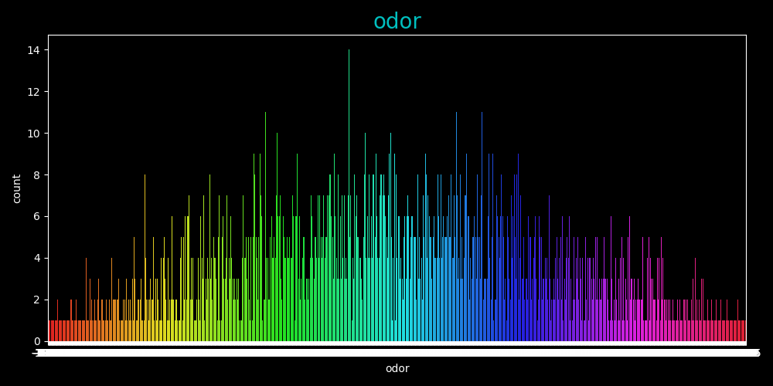
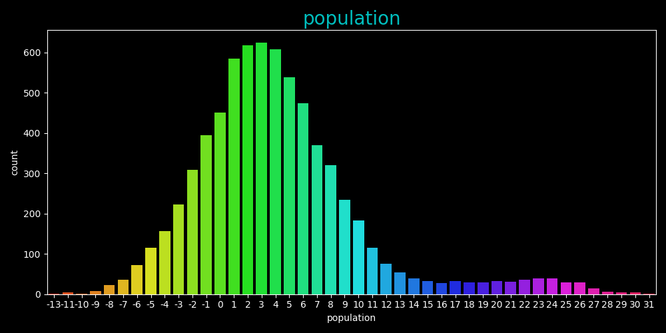
Classification Model
Gaussian naïve bayes
2 Features that will yield the best results for a GNB classifier are “odor” and “population”,
Because they are continuous and distributed normally which correspond best to GNB.
From their scatter plot, we can see that the decision boundary
will be a circle, and points who lay inside the circle will assign as 1,
Else, 0.

Slide 16
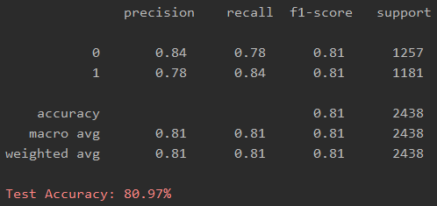
Classification Model
Decision Tree
Properties:
Using Sklearn, we can set some tree properties that can decrease the chance to over-fit the data.
Baseline Decision tree classification:

Slide 17
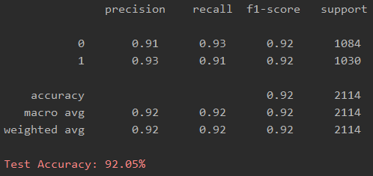
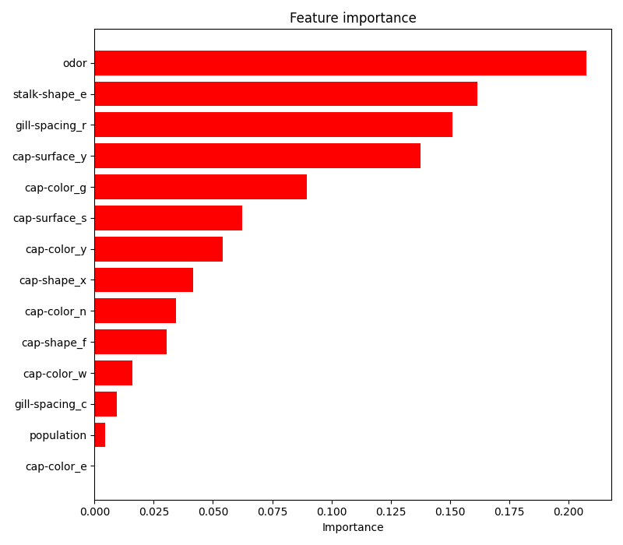
Classification Model
Decision Tree
Final decision tree classification report: Feature importance:
The test set accuracy increased by 10%-11% by cleaning and manipulating the dataset.
I manage to improve the performance, after the previous stages by:
Limit some tree properties such as Max depth, To avoid over-fitting.
Running the algorithm twice, and in the second time taking the most relevant features.

Slide 18
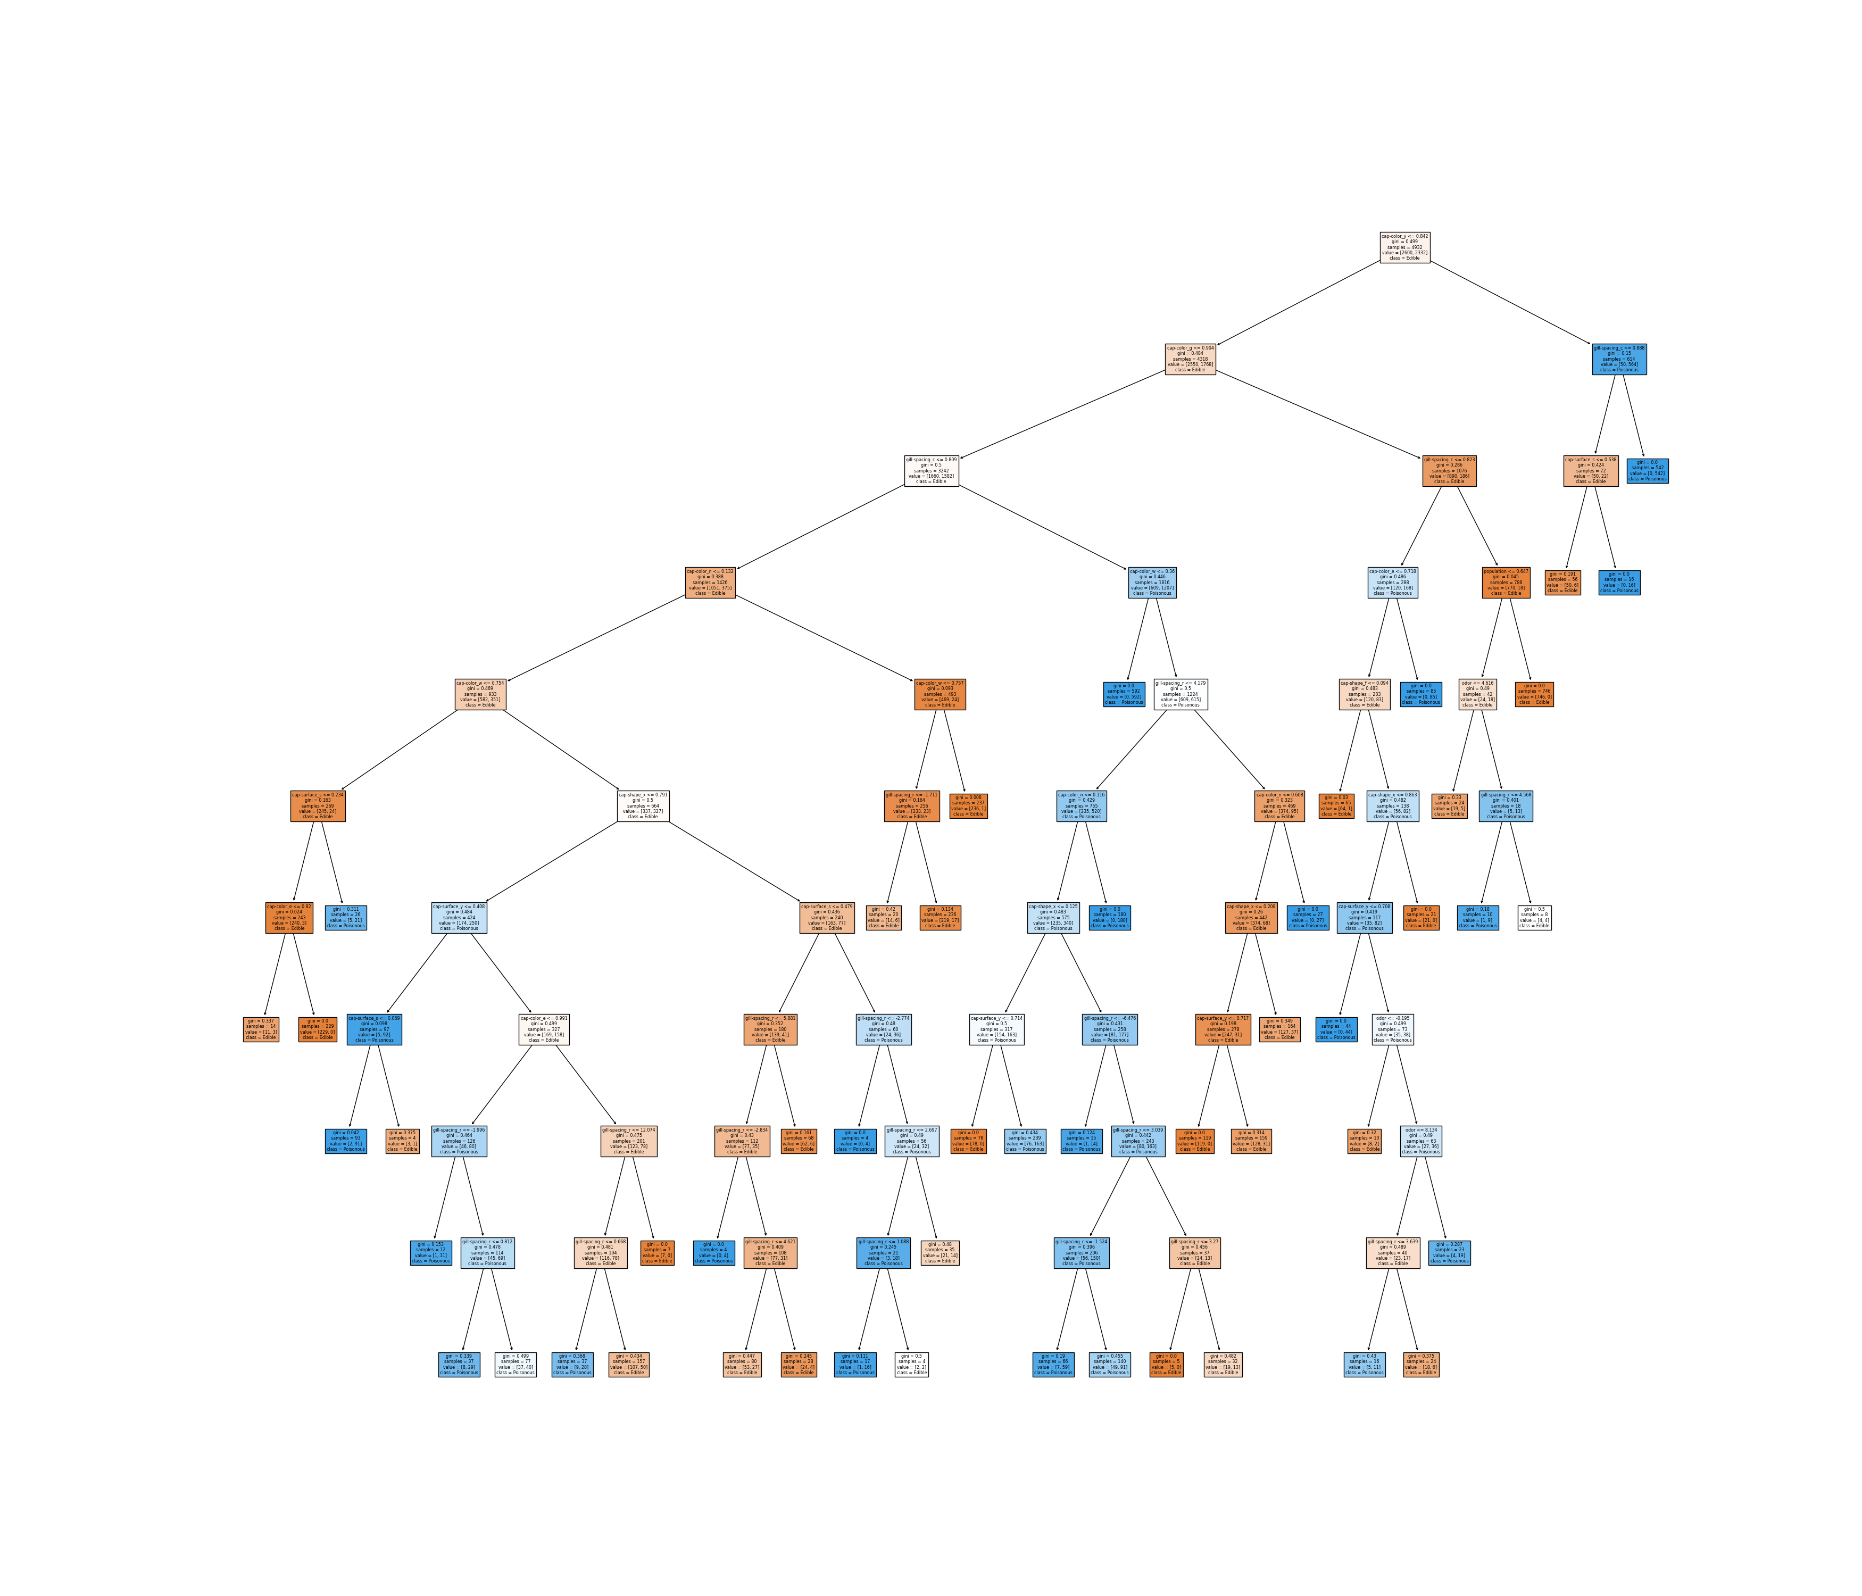

Slide 19
SUMMARY
During the work, I encountered many issues, some of them are:
Handling numerical and categorical data. I handle this issue using One-Hot-Encoding, which increase the number of features, but give better understanding of the data. After encoding, and outlier removal I notice that some features such as specific cap color were filled with 1 value, thus, they don’t have any effect, and can be removed.
Feature normalization. I tried different normalization techniques, but they didn’t have any effect on the results.
Over-fitting. Using the default decision tree, I noticed that the train set accuracy was 100%, and the test set accuracy was much lower, which means over-fitting. I handle this issue by limiting some tree properties to bound our tree.
The classification performance measure that best fits the data is the F1 score. The reason is that the F1 score includes the FP and FN metrics, which important for this kind of data when it can be deadly to eat a poisonous mushroom that is labeled as edible.

